Slide 1

MALLA REDDY COLLEGE OF ENGINEERING & TECHNOLOGY
Department of Aeronautical Engineering
MAJOR PROJECT
Design and Analysis of Hybrid VTOL Wing using Simple AI Algorithm
Under the Guidance of Presented by: Batch No: 2
Mr. M. Yugender SHAIK NAWAZ (20N31A2134)
Associate Professor TIRUMALA SAI NITHIN (20N31A2135)
V.HIMABINDU (20N31A2136)

Slide 2
ABSTRACT
This project focuses on the conceptualization, design, and analysis of a novel Hybrid Vertical Takeoff and Landing (VTOL) wing for a Radio-Controlled (RC) plane. The objective is to enhance the aircraft's versatility by integrating both fixed-wing and VTOL capabilities, allowing it to take off and land vertically while maintaining efficient forward flight. The research encompasses aerodynamic considerations, structural design, and control system integration to achieve optimal performance in various flight modes. Through a combination of theoretical modeling, computational simulations, and practical experimentation, the project aims to demonstrate the feasibility and efficiency of the proposed hybrid VTOL wing for RC planes. The outcomes of this study could contribute to advancements in the field of unmanned aerial vehicles, expanding the capabilities of RC aircraft for diverse applications.

Slide 3


LITERATURE REVIEW
Various research papers have explored innovative designs and propulsion systems for Vertical Take-Off and Landing (VTOL) Unmanned Aerial Vehicles (UAVs).
Design methodologies integrating fixed-wing and rotorcraft approaches have been developed to address challenges in UAV design.
Comprehensive aerodynamic analysis and simulations have been conducted to evaluate the performance of different UAV configurations.
Hybrid propulsion systems, including hybrid-electric and separate-lift-and-thrust designs, have demonstrated improved endurance and range capabilities.
Systematic approaches to conceptualization and testing have been employed to validate novel UAV concepts for diverse mission requirements.
Optimization techniques, such as Gaussian process optimization and mathematical-physical models, have been utilized to enhance UAV performance and efficiency.
Overall, the research highlights the ongoing evolution of VTOL technologies and emphasizes the importance of diverse technological applications to meet evolving operational requirements in civil and military sectors.

Slide 4
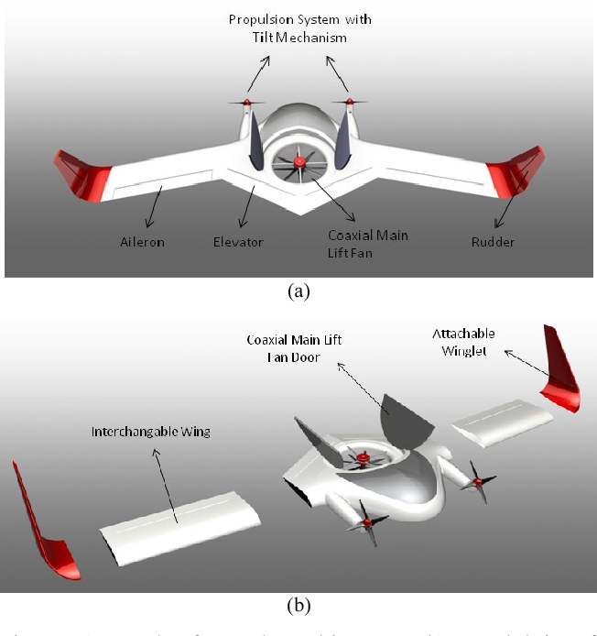
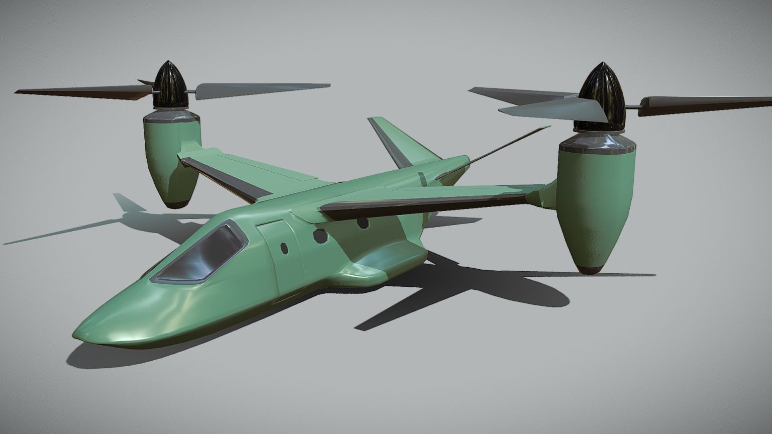
LITERATURE REVIEW - "Hybrid VTOL Design: Optimizing Wings for Enhanced Performance"
Hybrid VTOL Aircraft:
- Reviewing historical development and current state of VTOL aircraft.
- Exploring advantages and limitations of traditional designs like tiltrotors and tiltwings.
- Introducing the concept of hybrid VTOL aircraft for increased range and efficiency.
Wing Design and Analysis:
- Aerodynamic Considerations:
- Examining principles for lift generation and drag reduction.
- Reviewing methodologies for airfoil selection and wing geometry optimization.
- Structural Analysis:
- Discussing material selection and load distribution for structural integrity.
- Reviewing finite element analysis (FEA) techniques for evaluating wing performance.
Potential Benefits:
- Increased range and efficiency during cruise flight.
- Enhanced payload capacity for diverse mission requirements.
Case Studies:
- Analyzing performance characteristics of existing hybrid VTOL prototypes.
- Highlighting successful implementations and lessons learned from real-world applications.

Slide 5
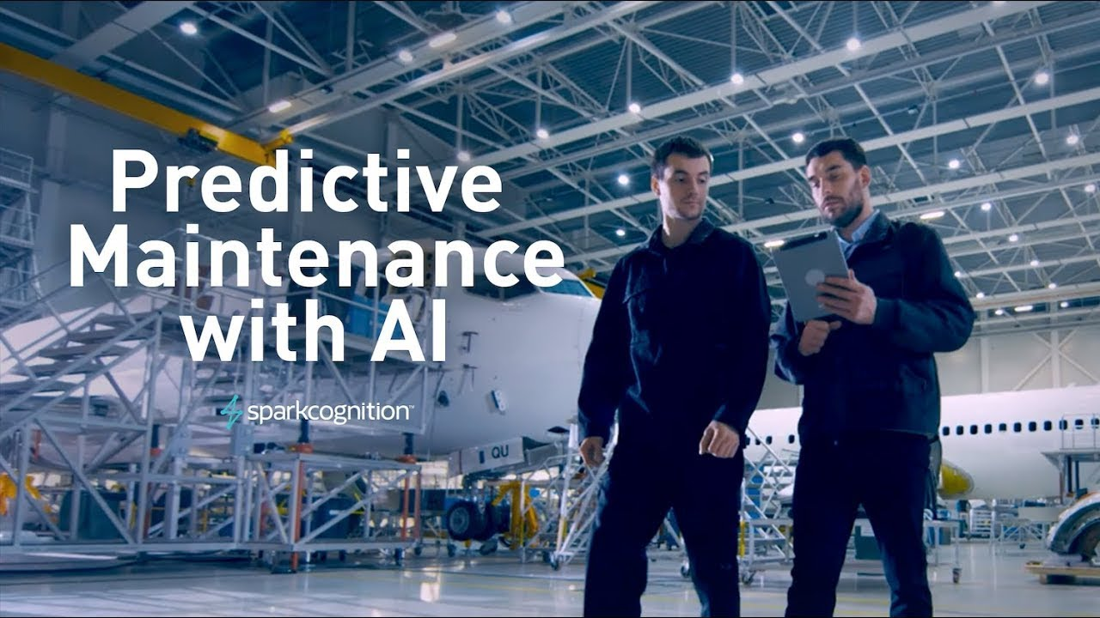

LITERATURE REVIEW - "AI Integration in Hybrid VTOL Wing Design: Optimizing Performance and Control"
AI Algorithms in Aerospace Engineering:
- Introduction to AI in Aerospace:
- Overview of AI applications including flight control systems and predictive maintenance.
- Reviewing machine learning algorithms for data analysis and decision-making.
AI for Flight Control:
- Exploration of AI algorithms for flight control optimization.
- Case studies of AI-based control systems in VTOL aircraft.
Integration of AI in Hybrid VTOL Wing Design:
Optimization Algorithms:
- Reviewing genetic algorithms, particle swarm optimization, and neural networks.
- Methodologies for multi-objective optimization considering aerodynamic efficiency and structural integrity.
Control Systems:
- Exploring adaptive control, reinforcement learning, and model predictive control.
- Discussing challenges in real-time implementation of AI-based control systems.

Slide 6
METHODOLOGY
Start
Define Project Goals
Literature Review
Data Collection
Final Analysis
End
Aerodynamic Analysis
Performance Evaluation
Integration With Wing Design
Optimization Process
AI Algorithm

Slide 7
METHODOLOGY – Wing design using xflr5
Start
Define Objectives
Determine Requirements
Wing Geometry
Validate with Simulation
Finalise Design Output
End
Airfoil Selection
Optimize Design
Analyse Result and Make Adjustments
Perform Analysis
Creation of 3D Model
Import to XFLR5
Airfoil Analysis
Wing Analysis

Slide 8
METHODOLOGY – ai algorithm
Lift & Drag
Start
Structural Analysis
Load Data from CSV File
Weight Estimation
Flight Performance
Power System Sizing
Perform Calculations
T/W ratio & Endurance
Plot Analysis Graphs
End
Control System Dynamics

Slide 9
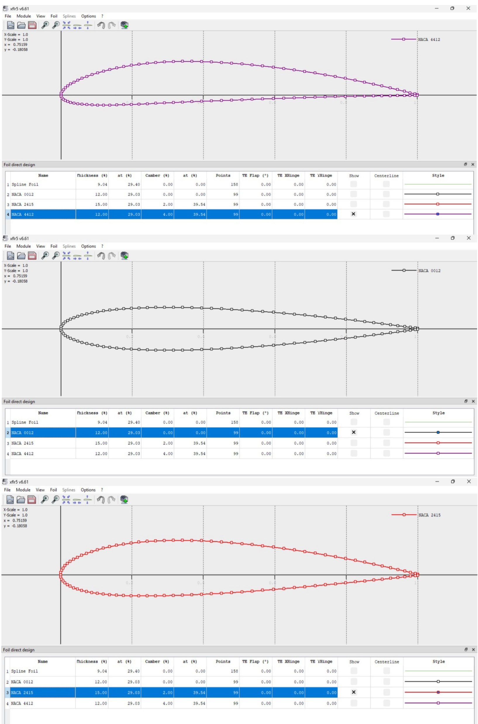
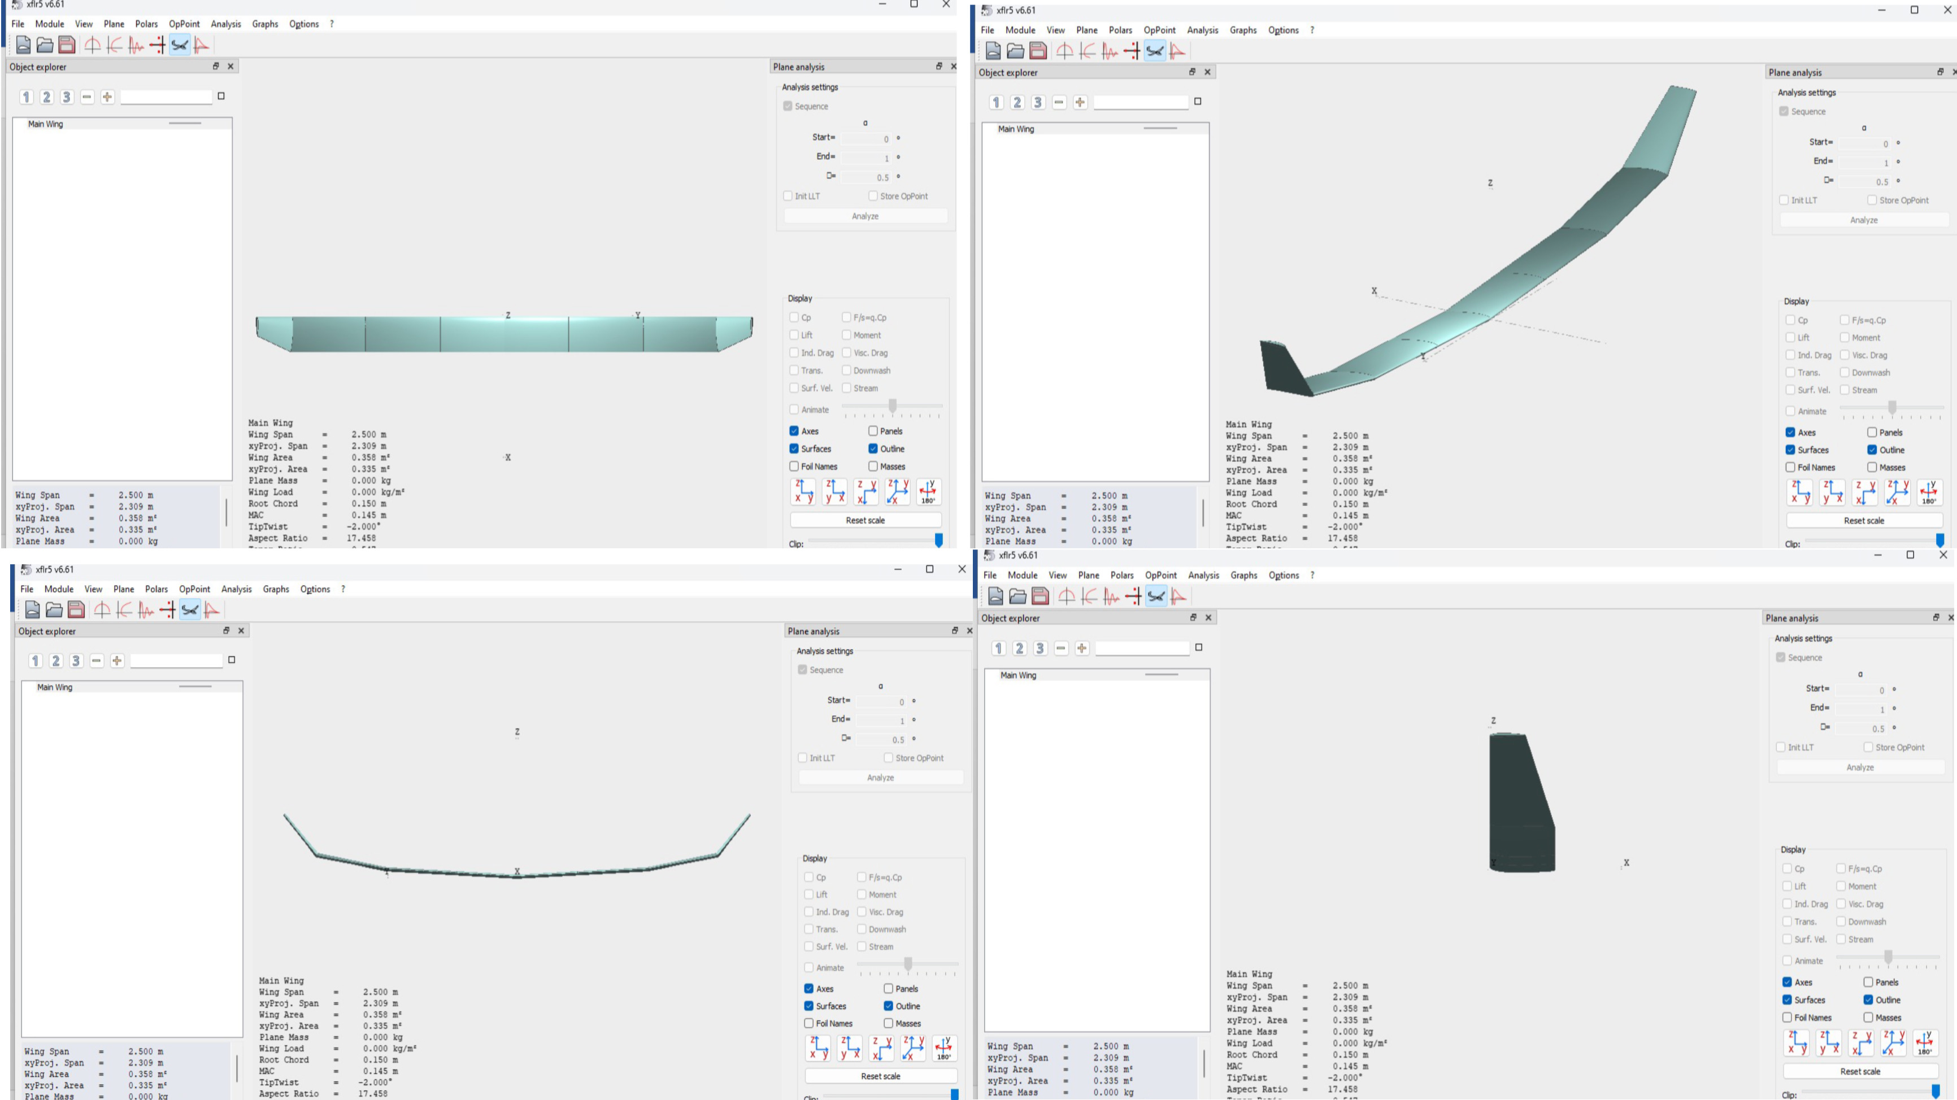
Results – Airfoil & Wing geometry
Airfoils - NACA0012, NACA2415, NACA4412
Isometric Views of Wing Geometry

Slide 10
AI CODE
import pandas as pd
import matplotlib.pyplot as plt
# Load data from CSV file
data = pd.read_csv("Structural_Analysis_data.csv")
# Define functions for analysis
def calculate_stresses(load, moment_of_inertia, distance_from_neutral_axis):
stress = load / moment_of_inertia * distance_from_neutral_axis
return stress
def calculate_bending_moments(load, distance):
bending_moment = load * distance
return bending_moment
def calculate_shear_forces(load):
shear_force = load
return shear_force
# Calculate stresses, bending moments, and shear forces using data from CSV
data['Stress'] = calculate_stresses(data['Load'], data['Moment_of_Inertia'], data['Distance_from_Neutral_Axis'])
data['Bending_Moment'] = calculate_bending_moments(data['Load'], data['Distance'])
data['Shear_Force'] = calculate_shear_forces(data['Load'])
# Plot stress, bending moment, and shear force
plt.figure(figsize=(15, 6))
plt.subplot(1, 3, 1)
plt.plot(data['Distance'], data['Stress'], label='Stress')
plt.xlabel('Distance')
plt.ylabel('Stress')
plt.title('Stress Distribution')
plt.grid(True)
plt.subplot(1, 3, 2)
plt.plot(data['Distance'], data['Bending_Moment'], label='Bending Moment')
plt.xlabel('Distance')
plt.ylabel('Bending Moment')
plt.title('Bending Moment Distribution')
plt.grid(True)
plt.subplot(1, 3, 3)
plt.plot(data['Distance'], data['Shear_Force'], label='Shear Force')
plt.xlabel('Distance')
plt.ylabel('Shear Force')
plt.title('Shear Force Distribution')
plt.grid(True)
plt.tight_layout()
plt.show()
import pandas as pd
import matplotlib.pyplot as plt
import numpy as np
# Load data from CSV file
data = pd.read_csv("Lift_Drag_data.csv")
# 1. Lift and Drag calculation
def calculate_lift_drag(airspeed, angle_of_attack, lift_coefficient, drag_coefficient):
lift = 0.5 * lift_coefficient * airspeed**2
drag = 0.5 * drag_coefficient * airspeed**2
return lift, drag
lift, drag = calculate_lift_drag(data['Airspeed'], data['Angle_of_Attack'], data['Lift_Coefficient'], data['Drag_Coefficient'])
# Plot Lift and Drag
plt.figure(figsize=(10, 6))
plt.plot(data['Airspeed'], lift, label='Lift')
plt.plot(data['Airspeed'], drag, label='Drag')
plt.xlabel('Airspeed')
plt.ylabel('Force')
plt.title('Lift and Drag vs. Airspeed')
plt.legend()
plt.grid(True)
plt.show()

Slide 11
AI CODE
import pandas as pd
import matplotlib.pyplot as plt
# Load data from CSV file
data = pd.read_csv("Weight_Analysis_data.csv")
# Define functions for weight estimation
def estimate_weight_structural_materials(wing_area, wing_loading, material_density):
weight_structural_materials = wing_area * wing_loading / 9.81 * material_density
return weight_structural_materials
def estimate_weight_propulsion_systems(propulsion_power):
weight_propulsion_systems = 0.1 * propulsion_power
return weight_propulsion_systems
def estimate_weight_control_surfaces(control_surface_area, control_surface_density):
weight_control_surfaces = control_surface_area * control_surface_density
return weight_control_surfaces
def estimate_weight_electronics(electronics_weight):
weight_electronics = electronics_weight
return weight_electronics
# Iterate over each row in the DataFrame
for index, row in data.iterrows():
# Extract data from the current row
wing_area = row['Wing_Area']
wing_loading = row['Wing_Loading']
material_density = row['Material_Density']
propulsion_power = row['Propulsion_Power']
control_surface_area = row['Control_Surface_Area']
control_surface_density = row['Control_Surface_Density']
electronics_weight = row['Electronics_Weight']
# Estimate weights
weight_structural_materials = estimate_weight_structural_materials(wing_area, wing_loading, material_density)
weight_propulsion_systems = estimate_weight_propulsion_systems(propulsion_power)
weight_control_surfaces = estimate_weight_control_surfaces(control_surface_area, control_surface_density)
weight_electronics = estimate_weight_electronics(electronics_weight)
# Total weight estimation
total_weight = (weight_structural_materials +
weight_propulsion_systems +
weight_control_surfaces +
weight_electronics)
# Print the estimated weights for the current dataset
print(f"Dataset {index + 1}:")
print("Estimated Weight of Structural Materials:", weight_structural_materials, "g")
print("Estimated Weight of Propulsion Systems:", weight_propulsion_systems, "g")
print("Estimated Weight of Control Surfaces:", weight_control_surfaces, "g")
print("Estimated Weight of Electronics:", weight_electronics, "g")
print("Total Estimated Weight of Wing:", total_weight, "g")
# Plotting
plt.figure(figsize=(15, 6))
plt.subplot(1, 2, 1)
plt.bar(['Structural Materials', 'Propulsion Systems', 'Control Surfaces', 'Electronics'],
[weight_structural_materials, weight_propulsion_systems, weight_control_surfaces, weight_electronics])
plt.xlabel('Component')
plt.ylabel('Weight (g)')
plt.title('Weight Distribution')
plt.grid(True)
plt.subplot(1, 2, 2)
plt.pie([weight_structural_materials, weight_propulsion_systems, weight_control_surfaces, weight_electronics],
labels=['Structural Materials', 'Propulsion Systems', 'Control Surfaces', 'Electronics'], autopct='%1.1f%%')
plt.title('Weight Distribution')
plt.axis('equal')
plt.tight_layout()
plt.show()

Slide 12
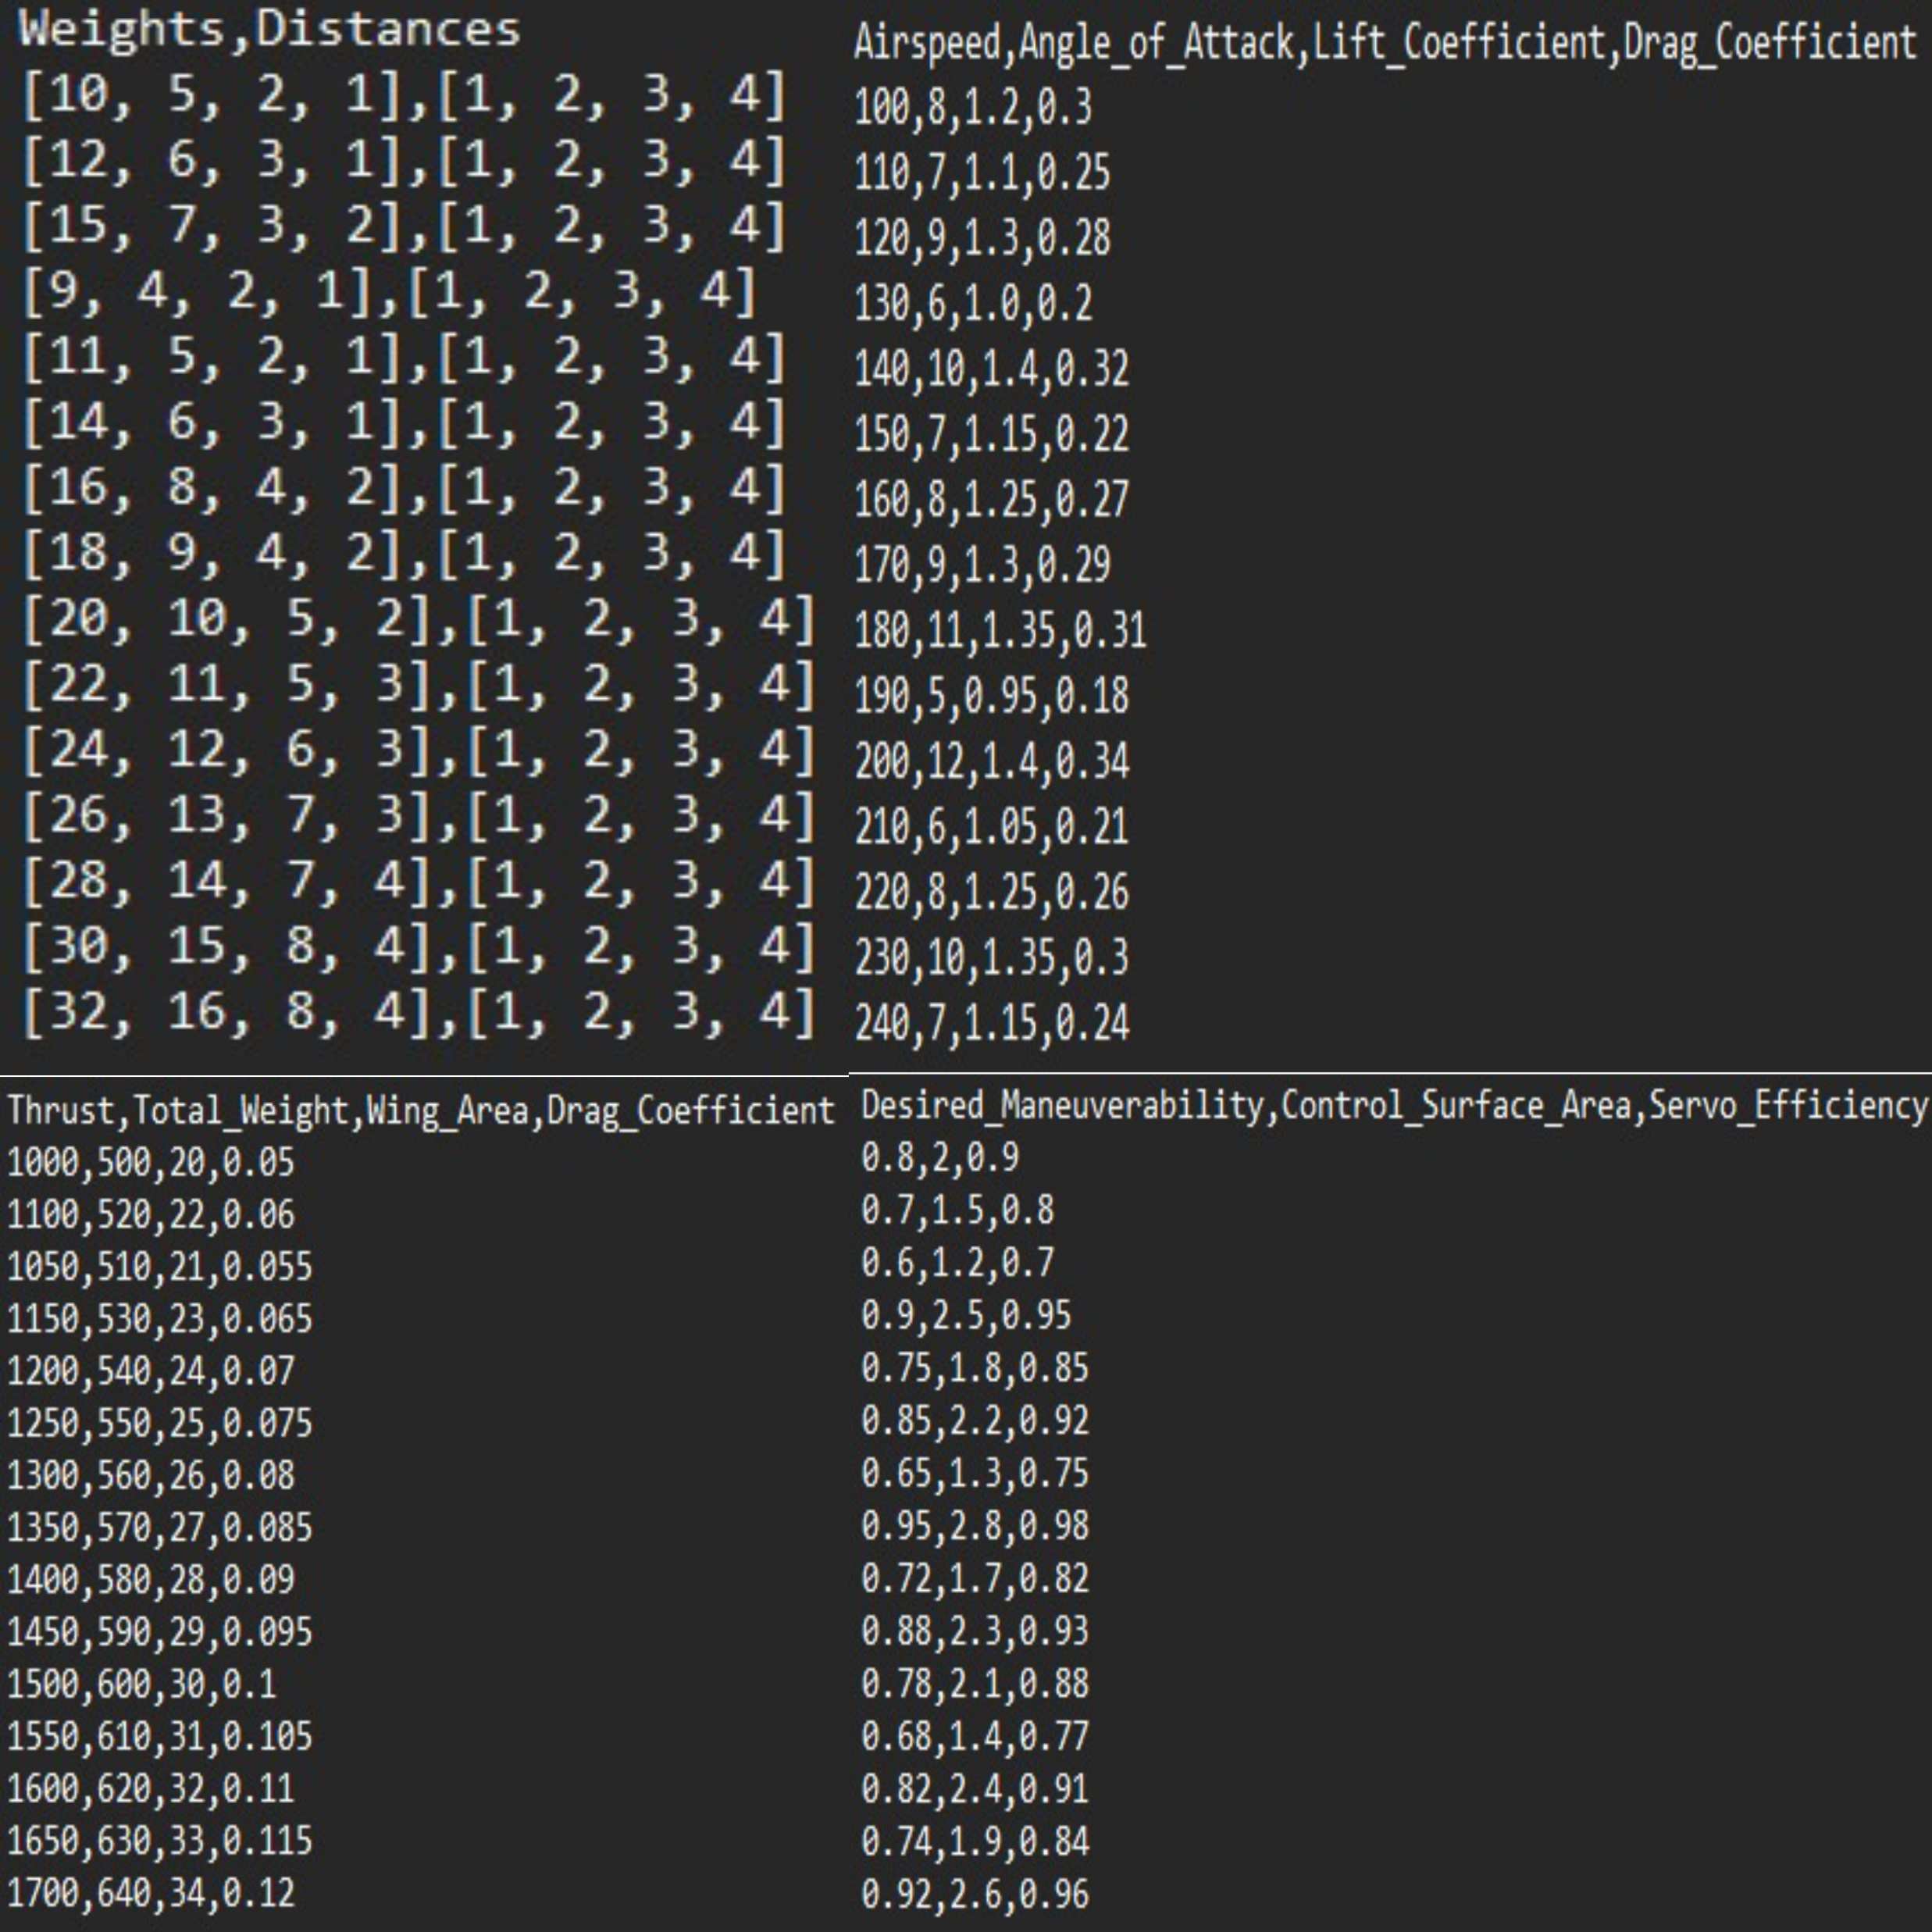
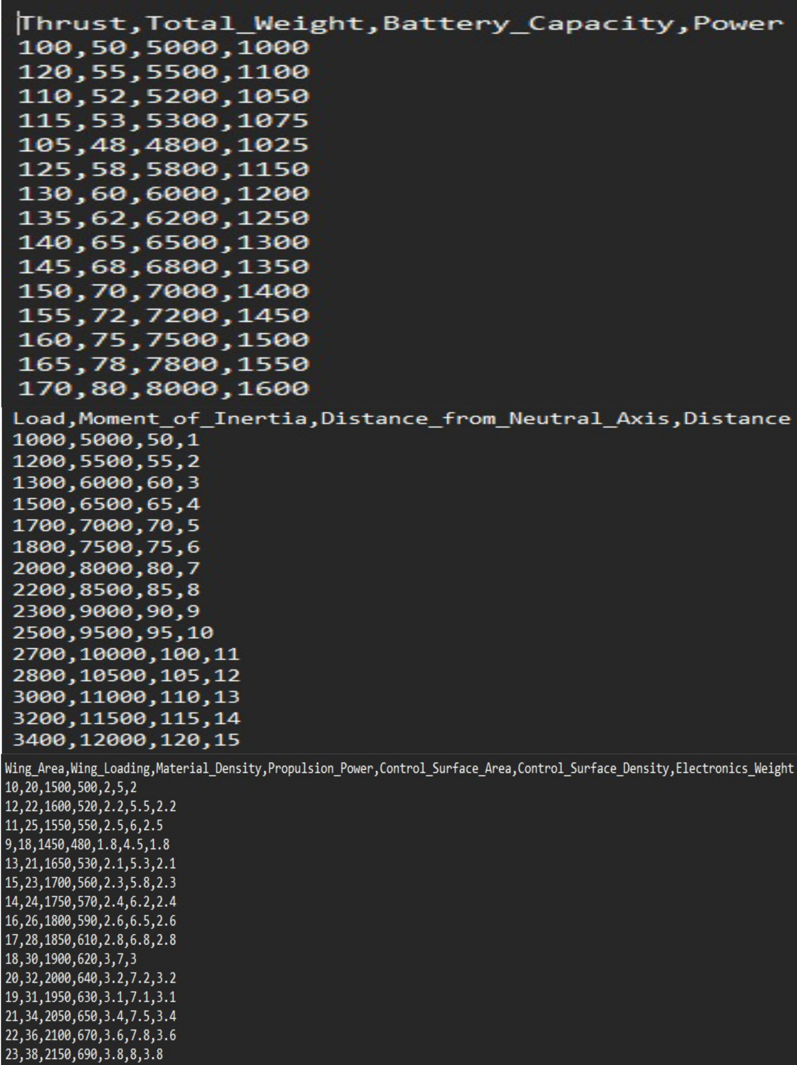
Input data for ai model – csv files

Slide 13
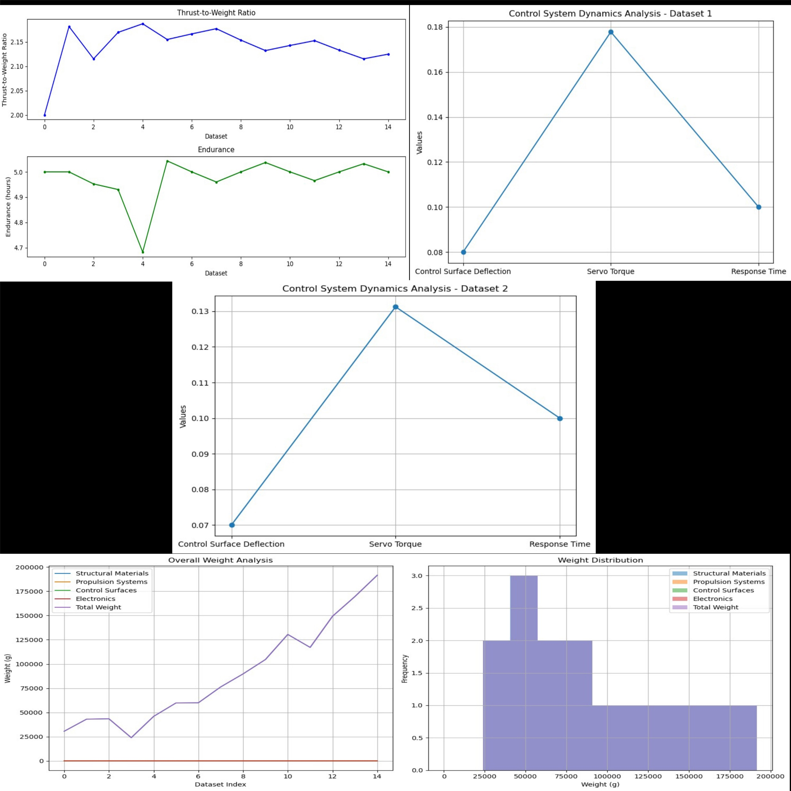
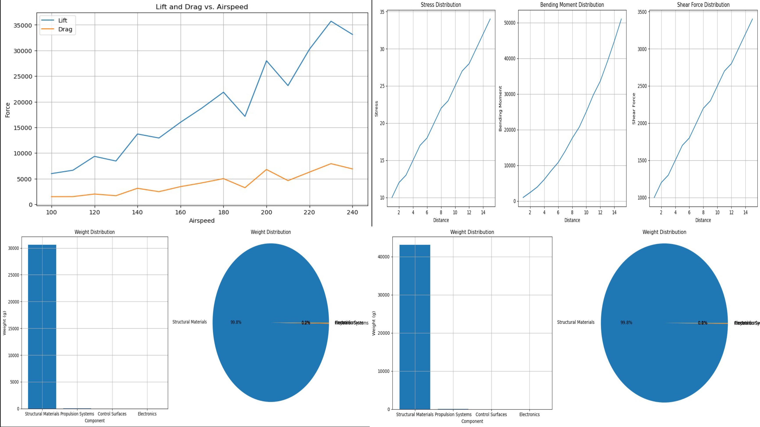
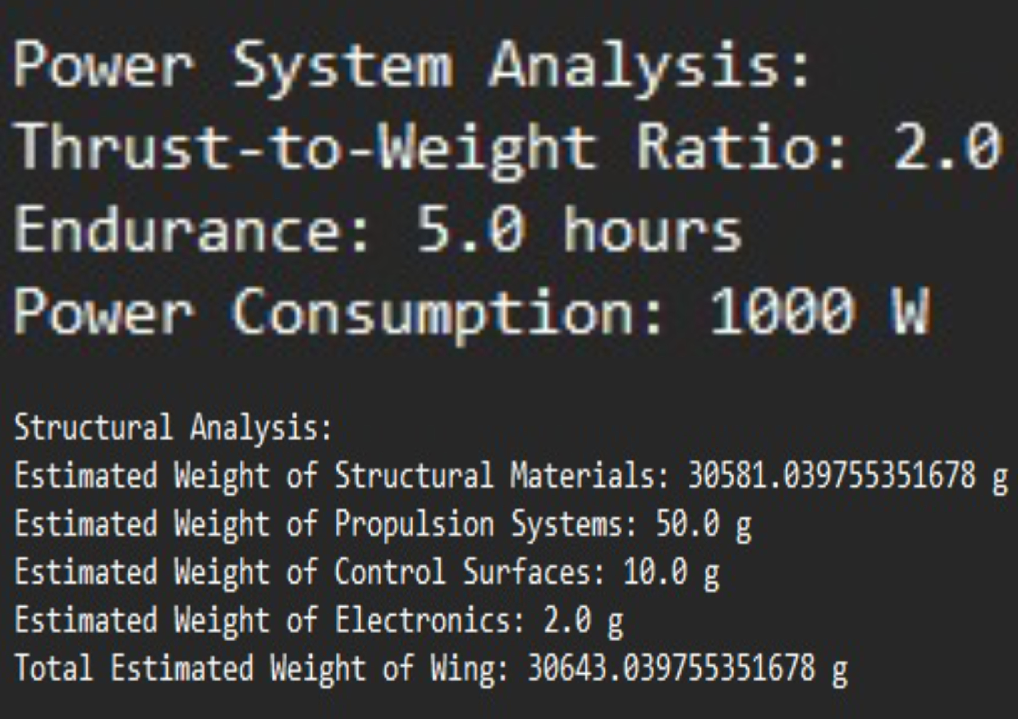
Results – Ai model
1. Lift and Drag Calculation
2. Structural Analysis
3. Weight Estimation
4. Power system Sizing
5. Control System Dynamics
6. Flight Performance prediction

Slide 14
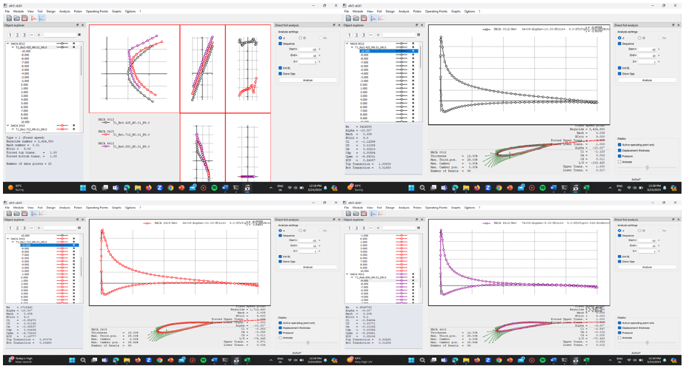
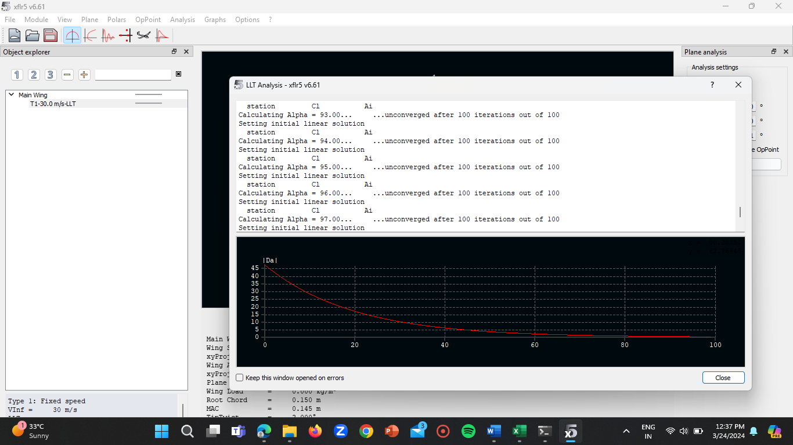
Results – Analysis in xflr5

Slide 15
Results – manual calculations
Wing Loading(WL):
WL = (W)/(S)
Where;
W = Weight of the Aircraft (kg)
S = Wing Area (m^2)
WL = 9/0.38
WL= 23.68 kg/m^2
Stall Speed (Vs):
Vs = sqrt [(2 x W)/ (density x S x CLmax)]
Where;
W = Weight of the plane
S = Wing Area
CLmax = Maximum Lift Coefficient [i.e, (1.5)]
Vs = sqrt [(2 x 9)/ (1.225 x 0.38 x 1.5)]
Vs = sqrt [(18)/ (0.86775)]
Vs = sqrt [20.747]Vs = 4.55 m/sec
Aspects Ratio(AR):
AR = b²/S
Where:
b = wing span
S = wing area
AR = (2.246)²/0.38
AR = 13.27

Slide 16

Conclusion & future scope
Conclusion:
1. Successful development and analysis of Hybrid VTOL Wing with NACA airfoils and AI.
2. Improved aerodynamic efficiency, stability, and maneuverability.
3. Versatile design suitable for various missions.
4. Further optimization opportunities exist.
Future Scope:
1. Advanced AI Algorithms: Optimize wing geometry using machine learning.
2. Structural Optimization: Enhance structural integrity with AI-driven weight reduction.
3. Energy-Efficient Propulsion: Investigate electric/hybrid powertrains with AI power management.
4. Autonomous Flight Control: Develop AI-based systems for precise navigation and obstacle avoidance.
5. Human-Centric Design: Optimize cockpit interface and training with AR/VR.
6. Collaborative Research: Foster partnerships for knowledge exchange and advancement.

Slide 17
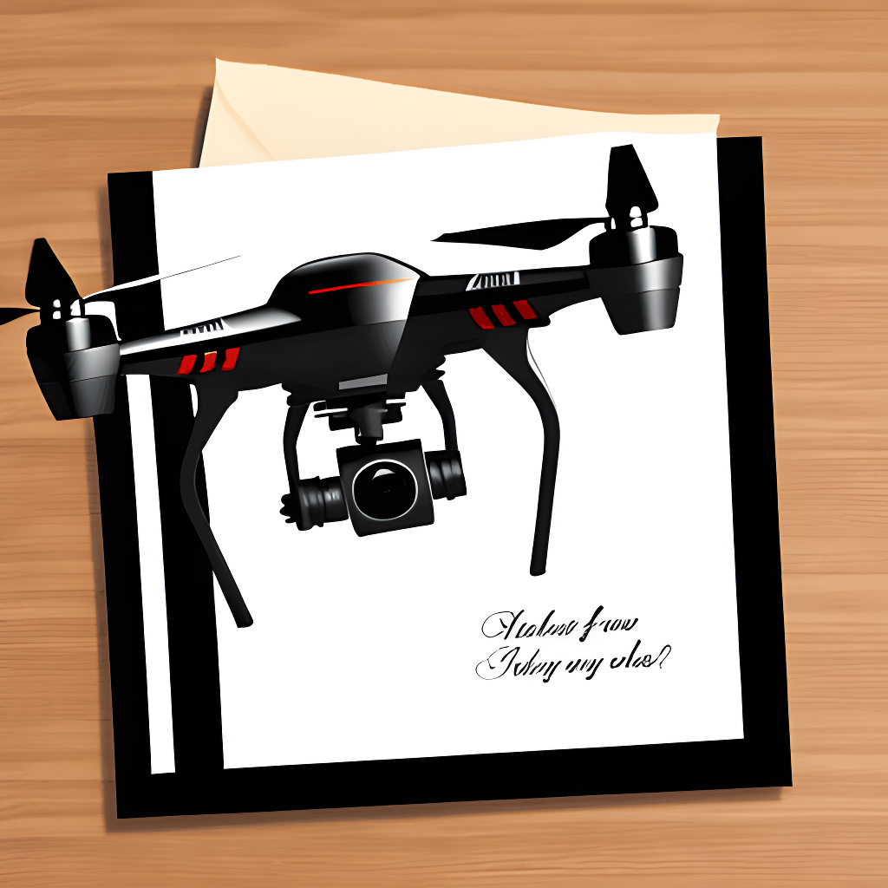
THANK YOU

